Slide 1

keV HHG and Sub femtosecond K-shell excitation.
( using IR (2.1μm) Radiation Source )
Gilad Marcus
The Department of Applied Physics,
The Hebrew University, Jerusalem, Israel
Tel Aviv, 2-4, December 2013

Slide 2


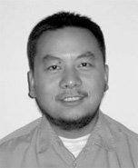

Acknowledgment
Ferenc Krausz ¹
Reinhard Kienberger ¹
Robert Hartmann ²
Takayoshi Kobayashi ³
Lothar Strueder ⁴
Yunpei Deng ¹
Xun Gu ¹
Wolfram Helml ¹
Max Planck, Quantum Optic, Germany
pnSensor GmbH, Germany
University of Electro-Communications, Chofu, Tokyo, Japan
Max Planck, Extraterrestrial Physics, Germany

Slide 3
Motivation for keV HHG
Currently, the photon energy of atto-second pulses is limited to ~150 eV ( λ~8 nm).
  Pushing the HHG toward the x-ray regime
    Shorter attosecond pulses
    Access to the water-window (300-500 eV)
    Time resolved spectroscopy of inner-shell processes
    X-ray diffraction imaging with a better resolution
  Re-colliding electrons with higher energies
    Laser induced diffraction imaging with better resolution

Slide 4
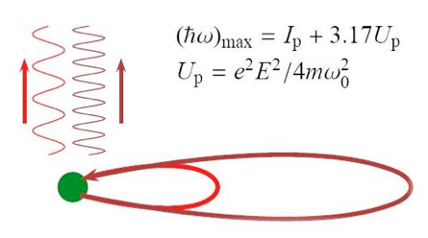
Currently, the photon energy of atto-second pulses is limited to ~150 eV ( λ~8 nm).
Increasing the energy of the re-colliding electrons
By using a longer wavelength
we can overcome the ionization
problem
I (PW/cm²) | 0.15 |  | 0.5 |  | 1.0
λ (nm) | 800 | 2100 | 800 | 2100 | 800 | 2100
U_{p} (eV) | 9.0 | 61.8 | 30 | 206 | 60 | 412
ħω_{max} (eV) | 44 | 211 | 110 | 668 | 205 | 1321

Slide 5
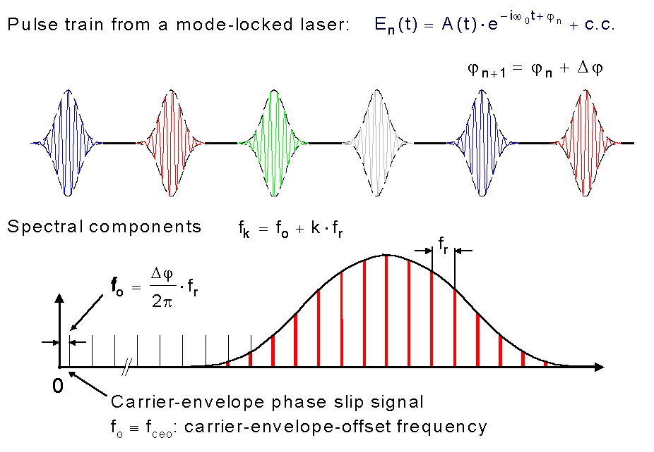
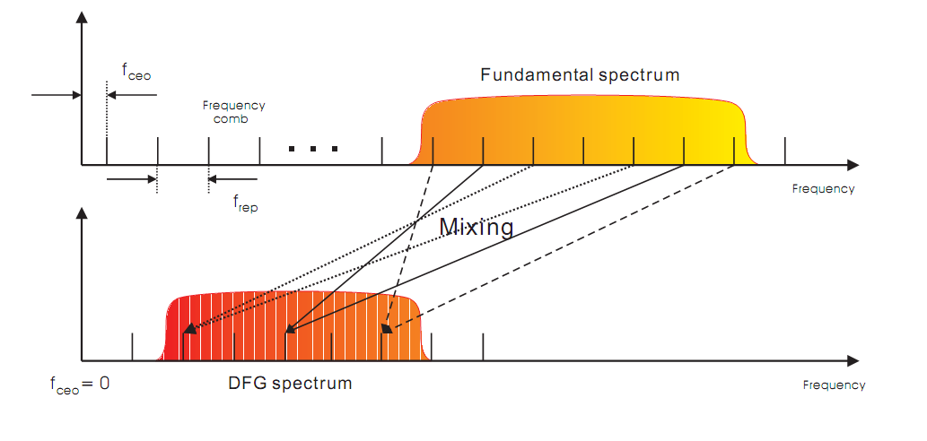
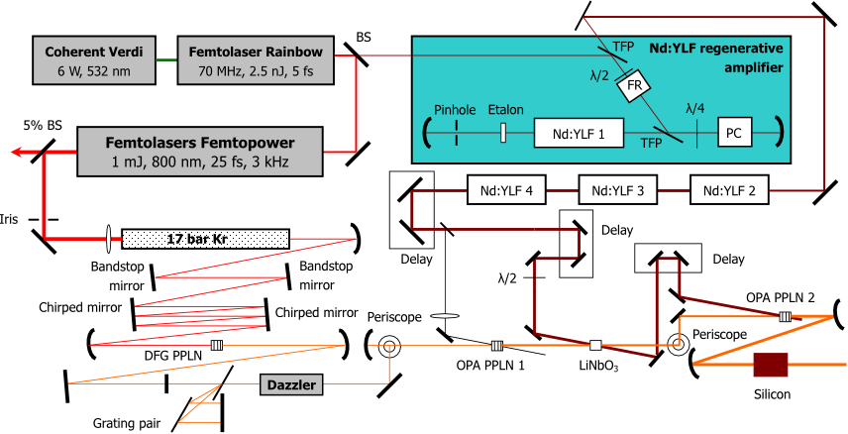
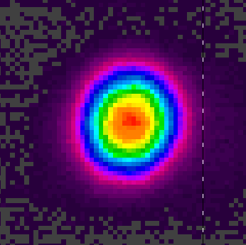
The 2-cycles IR source
Self CEP Stabilization
m
n
15 fsec
740 µJ
1 kHz

Slide 6

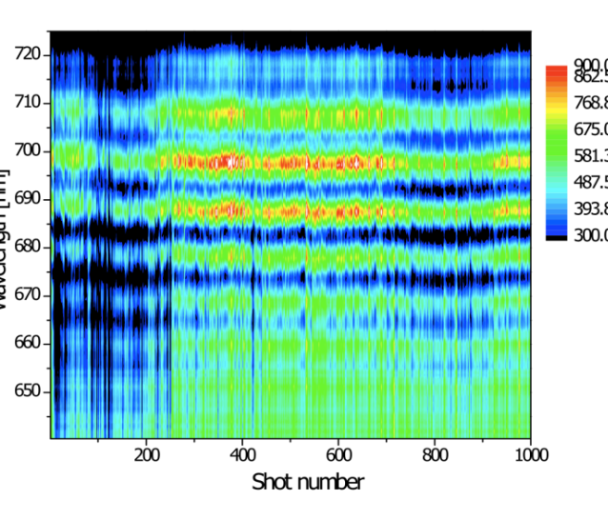
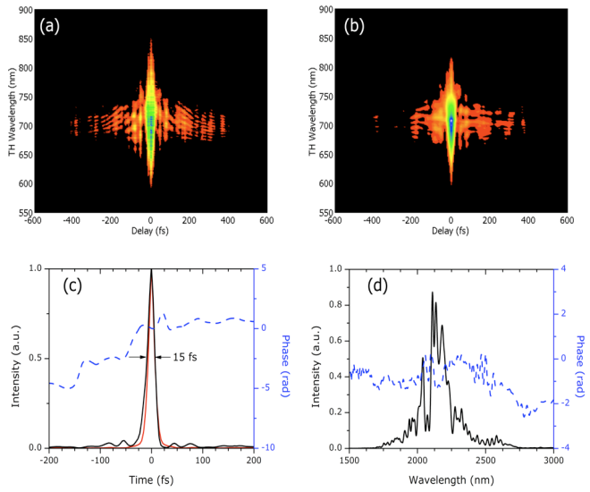
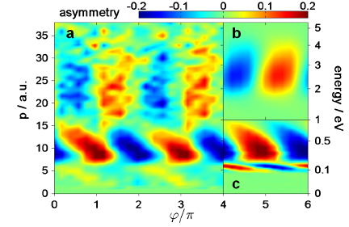
2 cycles IR (2.1μm) source
wavelength, nm
f-to-3f interferogram
OPA system output:
Carrier wave-length: λ=2.1μm
Pulse duration: 15.7 fs (2 cycles)
Pulse energy: 0.7 mJ
Rep rate: 1000 Hz
Automatically Carrier-envelope-phase-stabilized
Long term (few hours) phase scan
B.Bergues, et. al, New Journal of Physics 13, no. 6 ( 2011): 063010.
I. Znakovskaya, et al. PRL 108, no. 6 (2012): 063002.

Slide 7
High Harmonic Generation

Slide 8
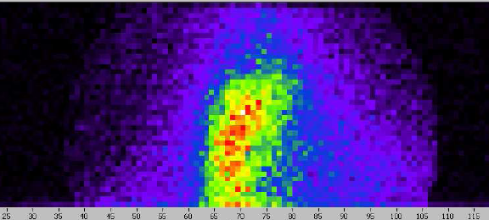
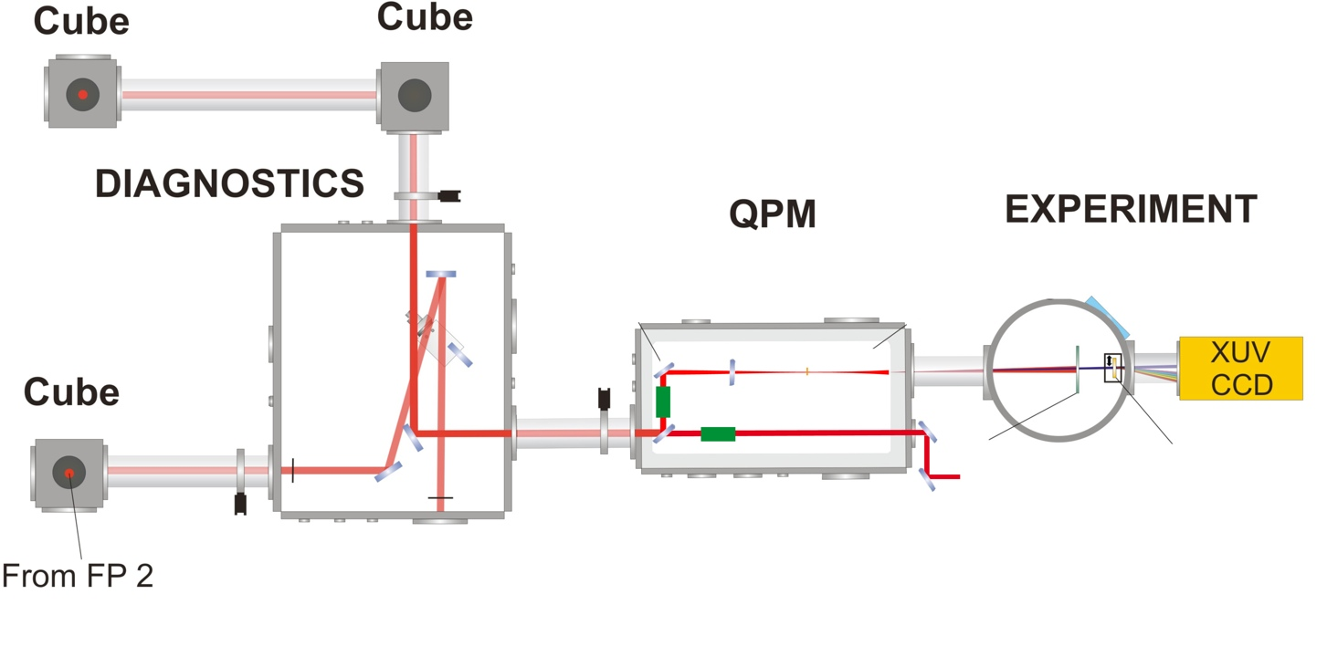
keV high harmonics and K-shell excitation
focusing lens
(CaF2, 250 mm)
Ne/N₂ gas target,
pressure up to 3 bar!
High harmonic beam from N₂ through 150nm Pd +500nm C
PN
Camera
THG FROG
THG FROG
Diagnostics for pulse
compression measurement
compressor
(bulk silicon)

Slide 9
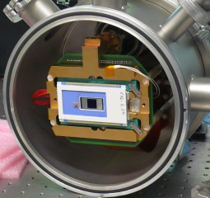
keV high harmonics and K-shell excitation
focusing lens
(CaF2, 250 mm)
Ne/N₂ gas target,
pressure up to 3 bar!
High harmonic beam from N₂ through 150nm Pd +500nm C
PN
Camera
THG FROG
THG FROG
Diagnostics for pulse
compression measurement
compressor
(bulk silicon)

Slide 10
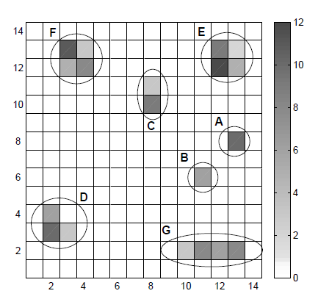
Photon counting and photon’s energy resolving with the pnCCD
Two photons hitting
two pixels.
The charge in each
pixel is proportional
to the photon energy

Slide 11
Photon counting and photon’s energy resolving with the pnCCD
Charge from one photons, spilled into neighboring pixels

Slide 12
Photon counting and photon’s energy resolving with the pnCCD
Rejected as an error.
Not a reasonable charge distribution
Cosmic ray trace

Slide 13
keV high harmonics and K-shell excitation
High harmonics spectrum
from a neon gas target
through 500nm aluminum
1.6 keV
Cut off
G. Marcus, et. al, PRL 108, 023201.
Vanadium L-edge
Iron L-edge
Same spectrum through
additional 500nm of
vanadium (a) or iron (b)

Slide 14
Photon counting and photon’s energy resolving with the pnCCD
Two photons hitting
two pixels.
The charge in each
pixel is proportional
to the photon energy

Slide 15
Photon counting and photon’s energy resolving with the pnCCD

Slide 16
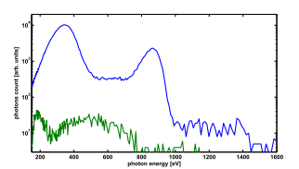
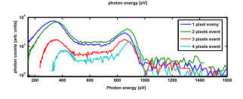
Real spectrum
Two pixels
pseudo photons

Slide 17
keV high harmonics and K-shell excitation
High harmonics spectrum
from a neon gas target
through 500nm aluminum
1.6 keV
Cut off
G. Marcus, et. al, PRL 108, 023201.
Vanadium L-edge
Iron L-edge
Same spectrum through
additional 500nm of
vanadium (a) or iron (b)

Slide 18
keV high harmonics and K-shell excitation

Slide 19
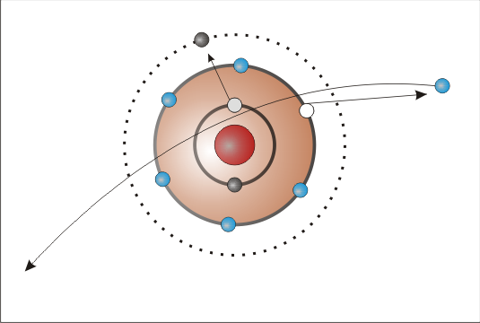
keV high harmonics and K-shell excitation
Enhanced peak at the K-edge
Better phase matching conditions
due to the absorption lines
Inner shell excitation followed
by x-ray emission

Slide 20
keV high harmonics and K-shell excitation
Enhanced peak at the K-edge
Calculation shows: Plasma
dispersion still dominate
Inner shell excitation followed
by x-ray emission

Slide 21
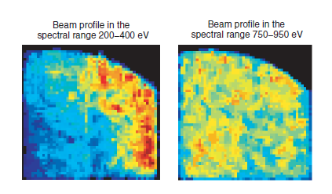
keV high harmonics and K-shell excitation
Enhanced peak at the K-edge
Inner shell excitation followed
by x-ray fluorescence

Slide 22
keV high harmonics and K-shell excitation
Enhanced peak at the K-edge
Inner shell excitation followed
by x-ray fluorescence
2D

Slide 23
keV high harmonics and K-shell excitation
Enhanced peak at the K-edge
Inner shell excitation followed
by x-ray fluorescence
2D

Slide 24
keV high harmonics and K-shell excitation
Enhanced peak at the K-edge
Inner shell excitation followed
by x-ray fluorescence
2D

Slide 25
keV high harmonics and K-shell excitation
Enhanced peak at the K-edge
Inner shell excitation followed
by x-ray fluorescence
2D

Slide 26

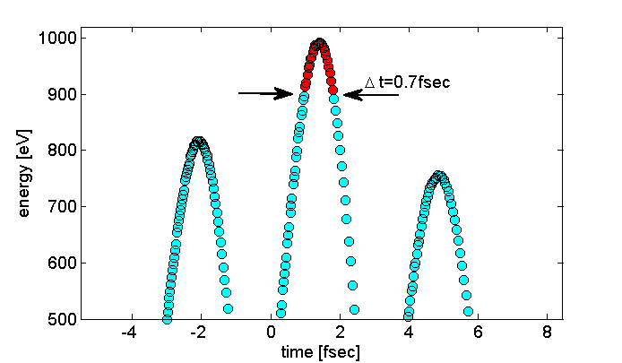
keV high harmonics and K-shell excitation
Inner shell excitation followed
by x-ray fluorescence

Slide 27
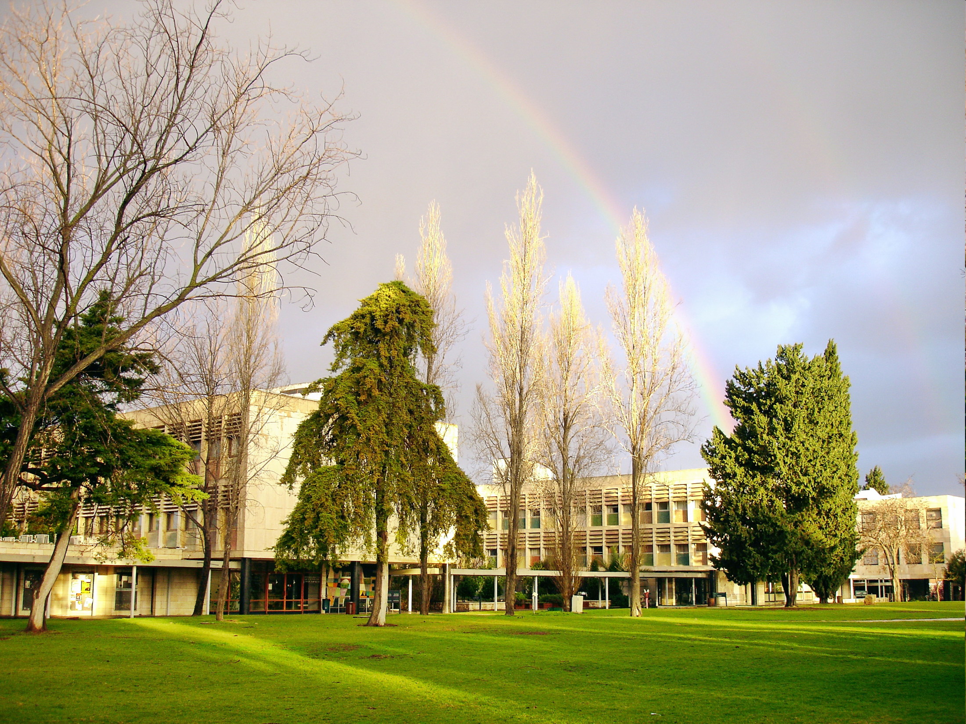
Thank you

